Slide 1
PROTECTING USER PASSWORD KEYS AT REST(ON THE DISK)
Under the guidance of:
Sujata V Mallapure

Slide 2
Contents
Introduction
Objectives
Encryption and Decryption process
Process flow
Implementation
Requirements
Conclusion

Slide 3
Introduction
In the digital era, the protection of sensitive information such as user passwords has become a critical concern. With the increasing frequency and sophistication of cyber-attacks, ensuring the security of user data stored on disk is essential to maintain privacy and trust.
Traditional methods of storing password keys in plaintext are highly vulnerable to unauthorized access, leading to potential data breaches and significant security risks.
To address these challenges, this project focuses on implementing a robust encryption mechanism to protect user password keys at rest using the Advanced Encryption Standard (AES) with a 256-bit key (AES-256). AES-256 is a widely recognized and trusted encryption standard that provides strong security due to its large key size and resistance to cryptographic attacks.
The primary objective of this project is to develop a secure method for encrypting user password keys before storing them on disk.

Slide 4
Objectives
Implement AES-256 Encryption
Generate Secure File Encryption Keys (FEKs)
Derive Key Encryption Keys (KEKs) from User Passphrases
Encrypt and Secure FEKs
Implement and Test the Solution

Slide 5
What Encryption and Decryption Is?
Encryption is the process of converting plain, readable data (plaintext) into an encoded format (ciphertext) that can only be read or decrypted by someone who possesses the appropriate decryption key. Encryption is used to ensure the confidentiality of data, protecting it from unauthorized access, even if the data is intercepted or accessed by unauthorized individuals.
The decryption process is the reverse of encryption. It involves converting the ciphertext back to plaintext using the appropriate decryption key.

Slide 6
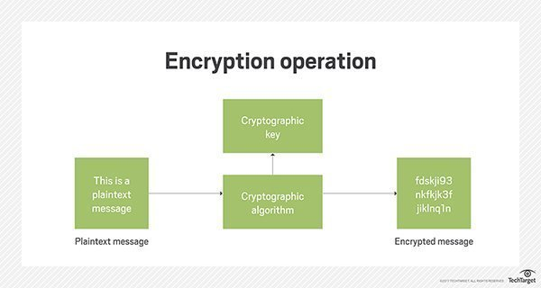
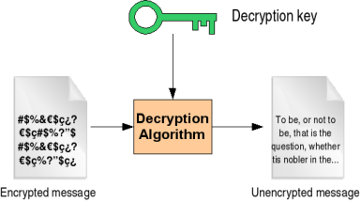
Process flow

Slide 7
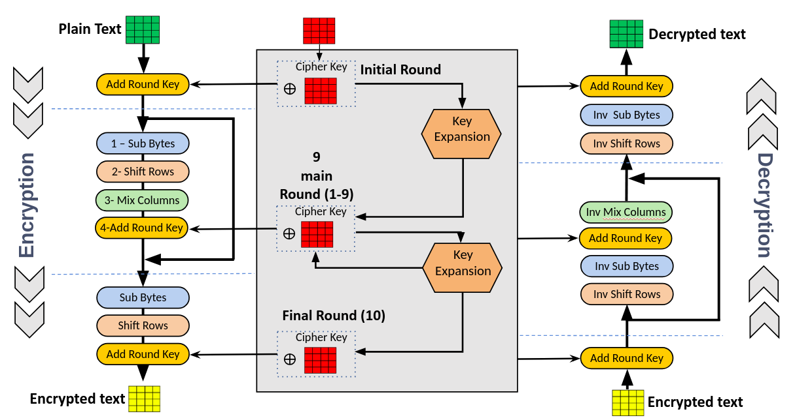

Slide 8
Implementation
Import Libraries: We import necessary libraries from PyCryptodome.
Constants: We define constants for sizes of salt, key, nonce, and tag, as well as the file name to save encrypted data.
Generate Key: The generate_key function creates a 256-bit key using the PBKDF2 function with a given password and salt.

Slide 9
Implementation
Encrypt Data: The encrypt_data function:
Generates a random salt and nonce.
Derives a key from the password and salt.
Encrypts the plaintext using AES-256 in EAX mode.
Saves the salt, nonce, tag, and ciphertext to a file.
Decrypt Data: The decrypt_data function:
Reads the salt, nonce, tag, and ciphertext from the file.
Derives the same key from the password and salt.
Decrypts the ciphertext and verifies the integrity using the tag

Slide 10
Hardware Requirements
1. Processor: Intel i5 or Intel i7
2. At least 500 GB
- SSD (RAM): 4 GB (minimum), 8 GB
3. Storage:
- Hard Drive:
4. Graphics: Integrated Graphics (minimum), Dedicated GPU (optional, for enhanced performance)
5. Network: Internet connection for downloading dependencies and resources
6. Peripherals: Standard keyboard, mouse, monitor, and optionally, external storage for backups

Slide 11
Software Requirements
1. Operating System: - Windows 10 or 11
2. Python: Version 3.12.4
3. Libraries: PyCryptodome (for cryptographic functions)
- Installation command: `pip install pycryptodome`
4. IDE/Code Editor: Visual Studio Code, PyCharm or Jupyter Notebook
5. Additional Tools:
- Github
- Virtual Environment
6. Documentation Tools:
- Microsoft Word - Microsoft powerpoint

Slide 12
Conclusion
The project on protecting user password keys at rest (on the disk) using AES-256 encryption effectively demonstrates the importance of securing sensitive data. Through the implementation of advanced encryption standards and robust cryptographic techniques, this project ensures that user password keys are protected from unauthorized access and potential breaches.
This project underscores the significance of adopting strong encryption methods to protect sensitive information in an increasingly digital world.
In conclusion, the successful implementation of AES-256 encryption for protecting user password keys at rest demonstrates a robust approach to data security. This project serves as a valuable reference for developers and security professionals seeking to implement similar encryption solutions to safeguard sensitive information.

Slide 13
Team Members And Contributions
Team leader Akshita Navale
I have worked completely on project report , making presentation and github repository.
Member 1: Shraddha C.R
Member 2: Sejal Parikh
There role was to work on coding part and modifications.
We as a team have worked greatly on this project with a coordination and our mentor’s support.

Slide 14
THANK YOU…..

